Slide 1
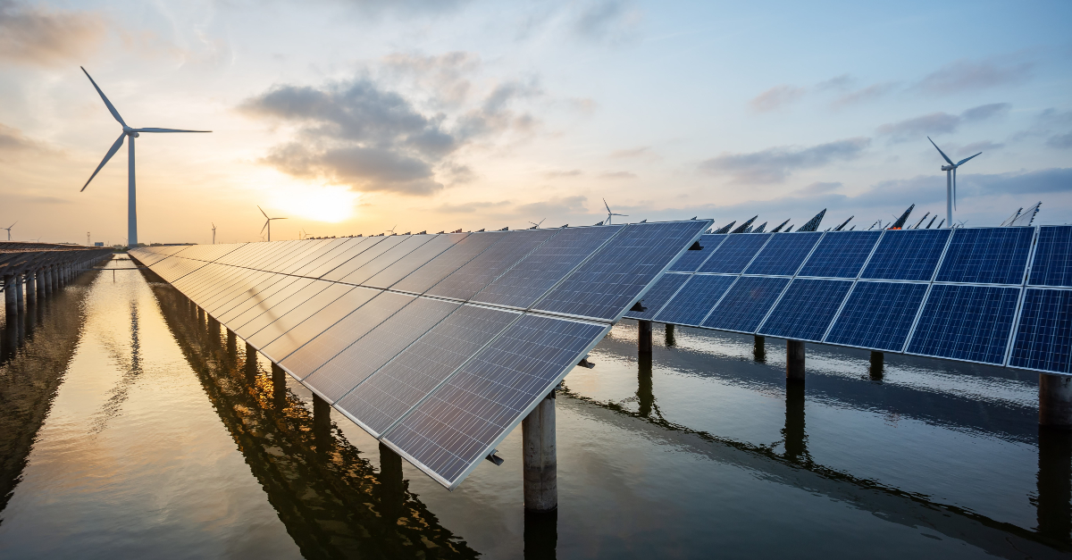
Energy sources
Chapter 40
Notes:
https://studentenergy.org/map/
https://studentenergy.org/energy-education/topics/

Slide 2

Distinguish between the various forms of energy
Appreciate how the future energy needs on earth can be met.
Understand the 3 main methods by which heat is transferred
Notes:
https://www.curriculumonline.ie/getmedia/cd97acf7-dafb-464e-9dc9-9b01086cc3df/Meeting-Current-and-Future-Energy-Needs_2.pdf

Slide 3
1. What forms of energy are used in the home?
2. Where does our energy come from?
3. Energy sources can be classified into two types.
What are these?

Slide 4
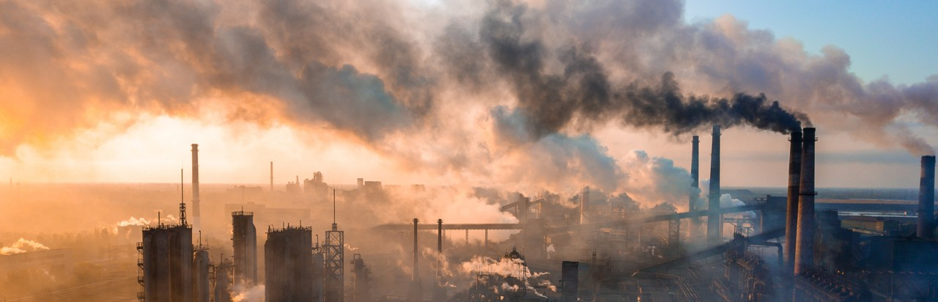
Powering an island is a complicated business, even before concerns over energy security and the climate crisis are taken into account.

Slide 5
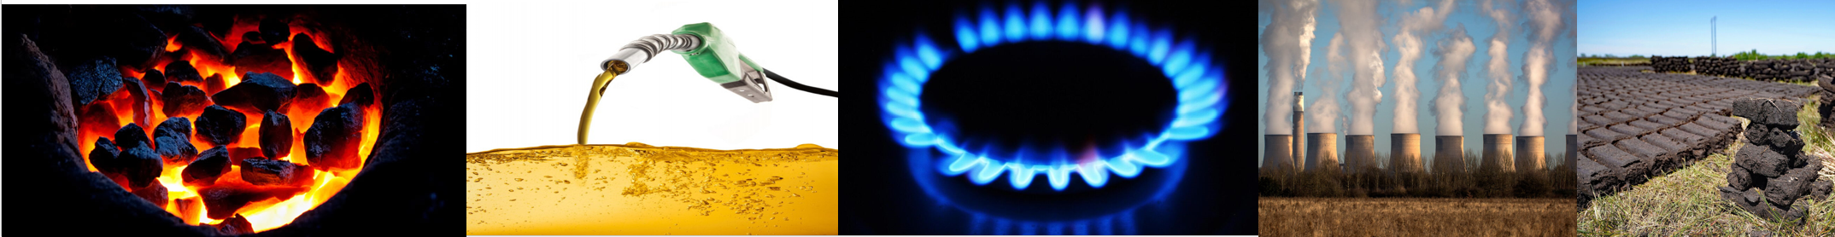
Non – renewable resources
Are limited resources that will run out and that we will be unable to replace
We call these fossil fuels.
Fossil fuels are the remains of dead plants and animals from millions of years ago.

Slide 6

The advantages & disadvantages of non –renewable energy sources
Reliable
Cheap
Eventually run out
Release carbon dioxide – pollutant

Slide 7
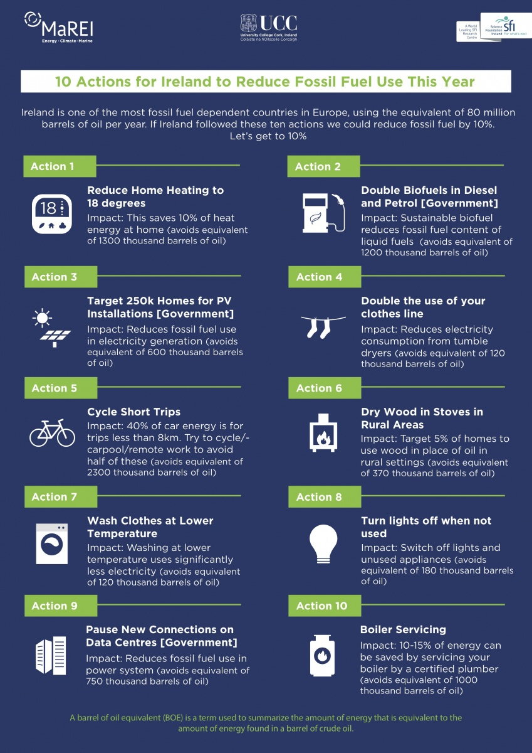

Slide 8
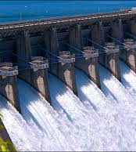
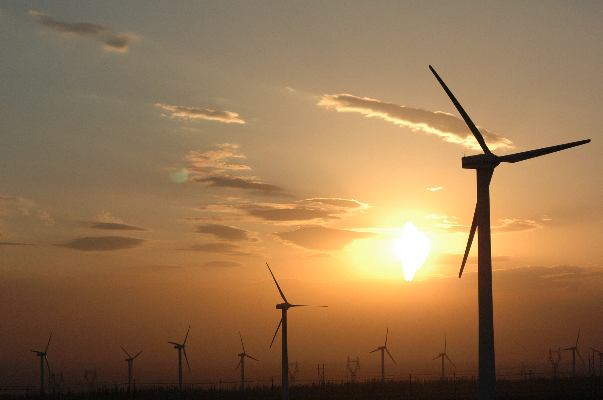
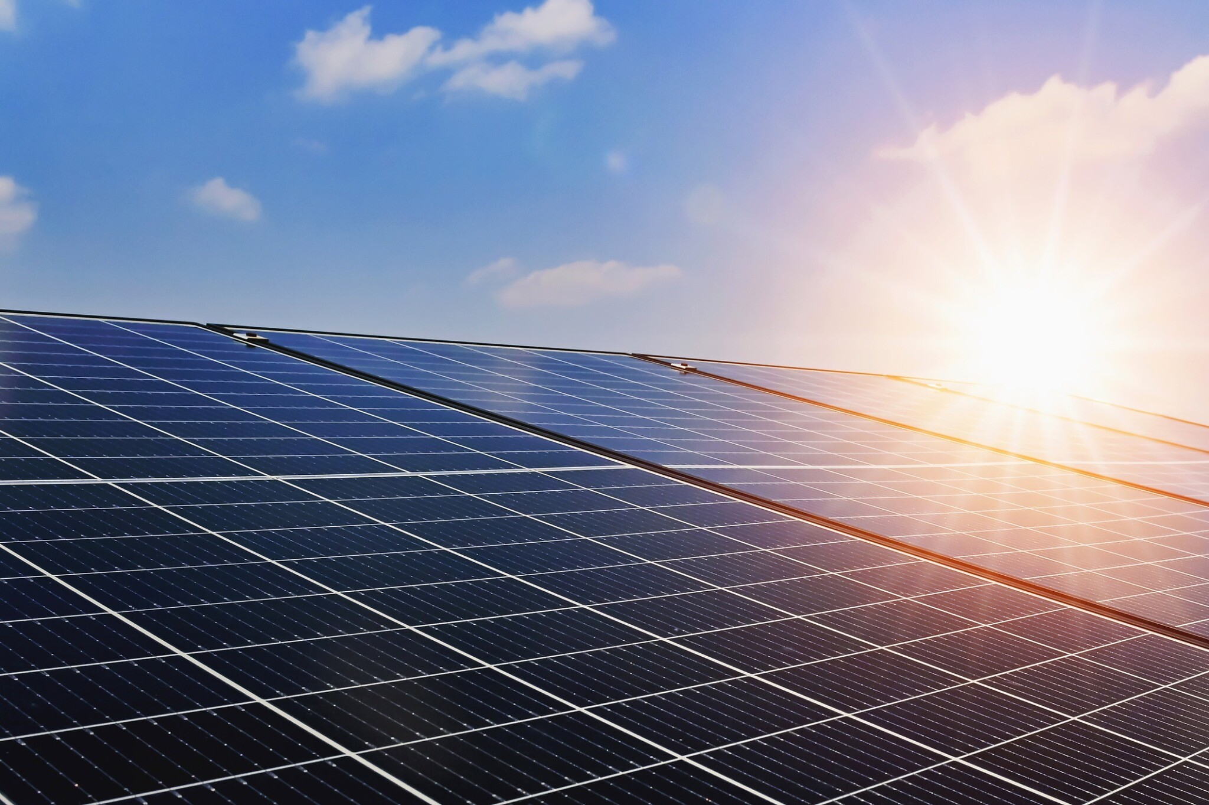
Renewable resources
Can be replaced and will not run out in the short term
Notes:
Constantly replaced by nature and can be used again and again

Slide 9

Can you name any types of renewable energy

Slide 10
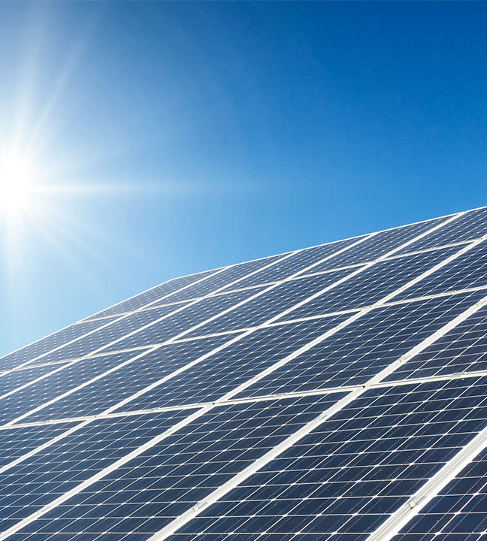
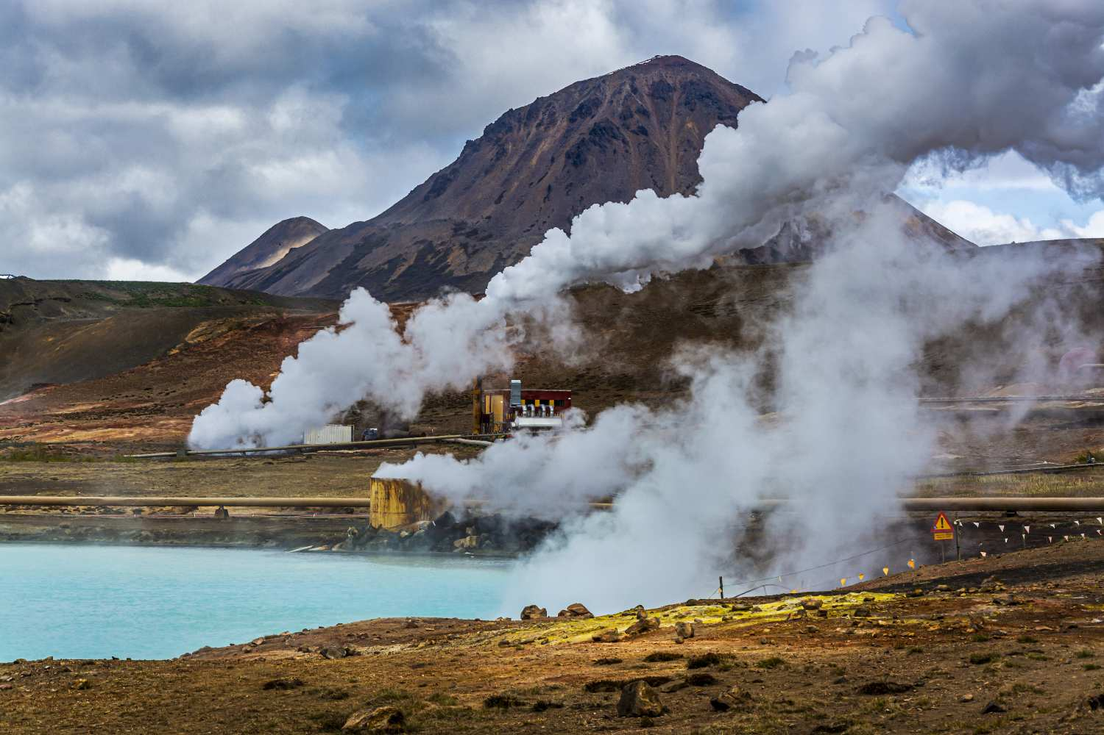
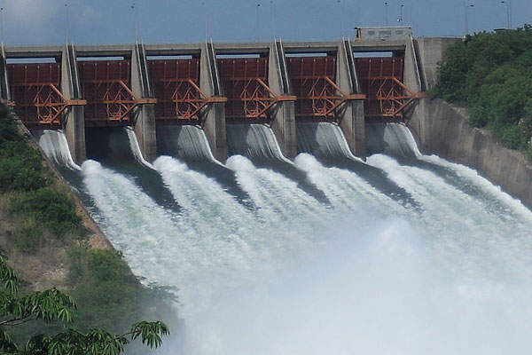
Renewable resources examples
Wind power – turbines/windmills
Water / hydroelectric
Biofuel
Geothermal
Solar panels/ tubes
Solar cells

Slide 11
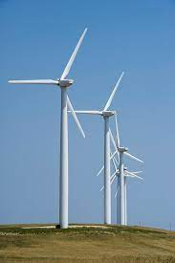
Wind energy
A wind turbine converts kinetic energy into electrical energy.
In recent years, wind farms have generated up 85 % of renewable energy and 30 % of our total energy in Ireland.
Energy change:
kinetic energy electrical energy
Notes:
Ireland has some of the best wind resources in Europe
Off shore/ on shore
Advantages: sustainable source– never run out
No carbon emissions
Disadvantages: only works in windy conditions
noise pollution
neg effect wildlife/ landscape

Slide 12

Notes:
https://www.youtube.com/watch?v=0Kx3qj_oRCc

Slide 13
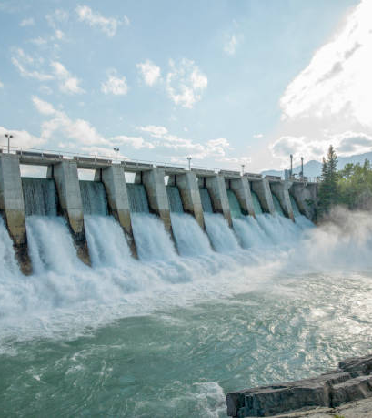
Water/ hydroelectric energy
This energy is using the energy within moving or falling water and changing it into electrical energy.
Water is held by behind a dam and when it is released it turns turbines in the dam to generate electricity.
Energy change:
Potential energy kinetic energy electrical energy
Notes:
Water is

Slide 14

Notes:
https://www.youtube.com/watch?v=pEUzot8Zufo

Slide 15
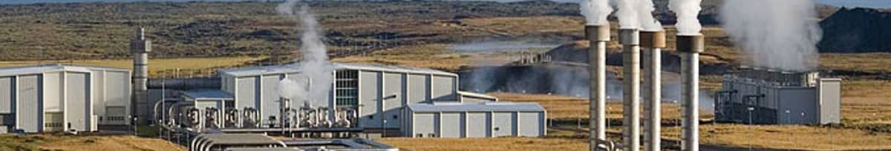
Geothermal energy
Uses heat contained under the earths surface.
Water is pumped through pipes deep underground, where it is warmed by the earth before returning to the surface.
Used to heat homes.
Energy change:
Heat energy kinetic energy electrical energy.
Notes:
Iceland & New Zeeland.
Adv: reliable
no release of co2
Dis: Expensive
only available in certain parts of the world

Slide 16

Notes:
https://www.youtube.com/watch?v=j7q653ffQO4

Slide 17


Solar cells
These cells are found in devices that transform light energy to electrical energy.
E.g. solar powered calculator, electronic toys.
Energy change:
Light energy electrical energy.

Slide 18
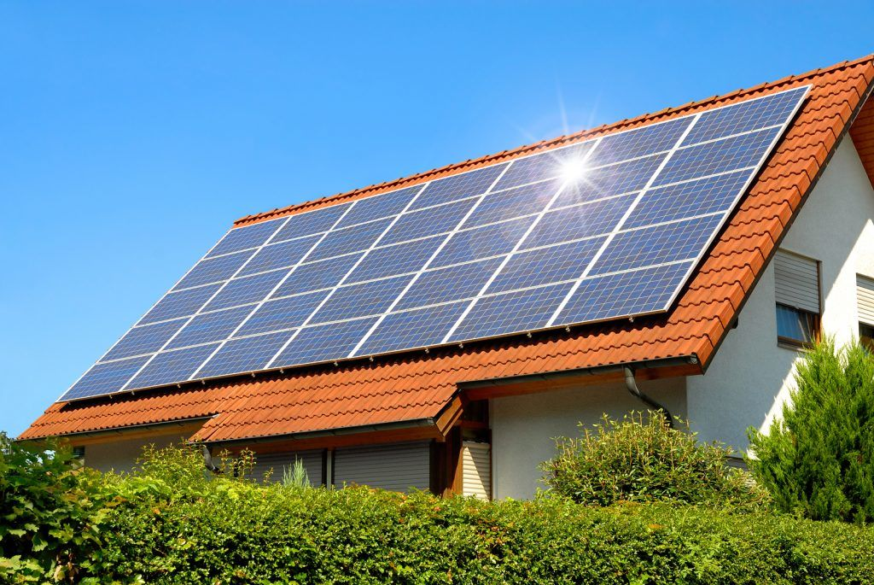
Solar panels
Solar panels heat water that runs through them.
Energy change:
Light/solar energy Heat energy.

Slide 19
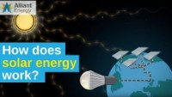
Notes:
https://www.youtube.com/watch?v=GzQmo_Wd2Sw

Slide 20
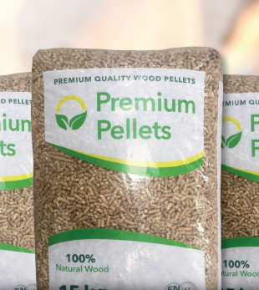
Biofuel
The burning of fuel that comes from living things.
Woodchips/ wood pellets produced from waste timber products can be burned to provide heat.
Biofuels – biodiesel produced from plant oils – rapeseed oil can provide fuels for vehicles.
Its only renewable if trees/ plants are replaced.
Energy change:
Chemical energy Heat/ kinetic energy
Notes:
Ad: efficient
Produces less emissions
Easy to produce
Dis: using tree/ plants effect bio

Slide 21

Notes:
https://www.youtube.com/watch?v=nVl17JLn_u0

Slide 22
What are the most suitable sources of renewable energy for Ireland and why

Slide 23
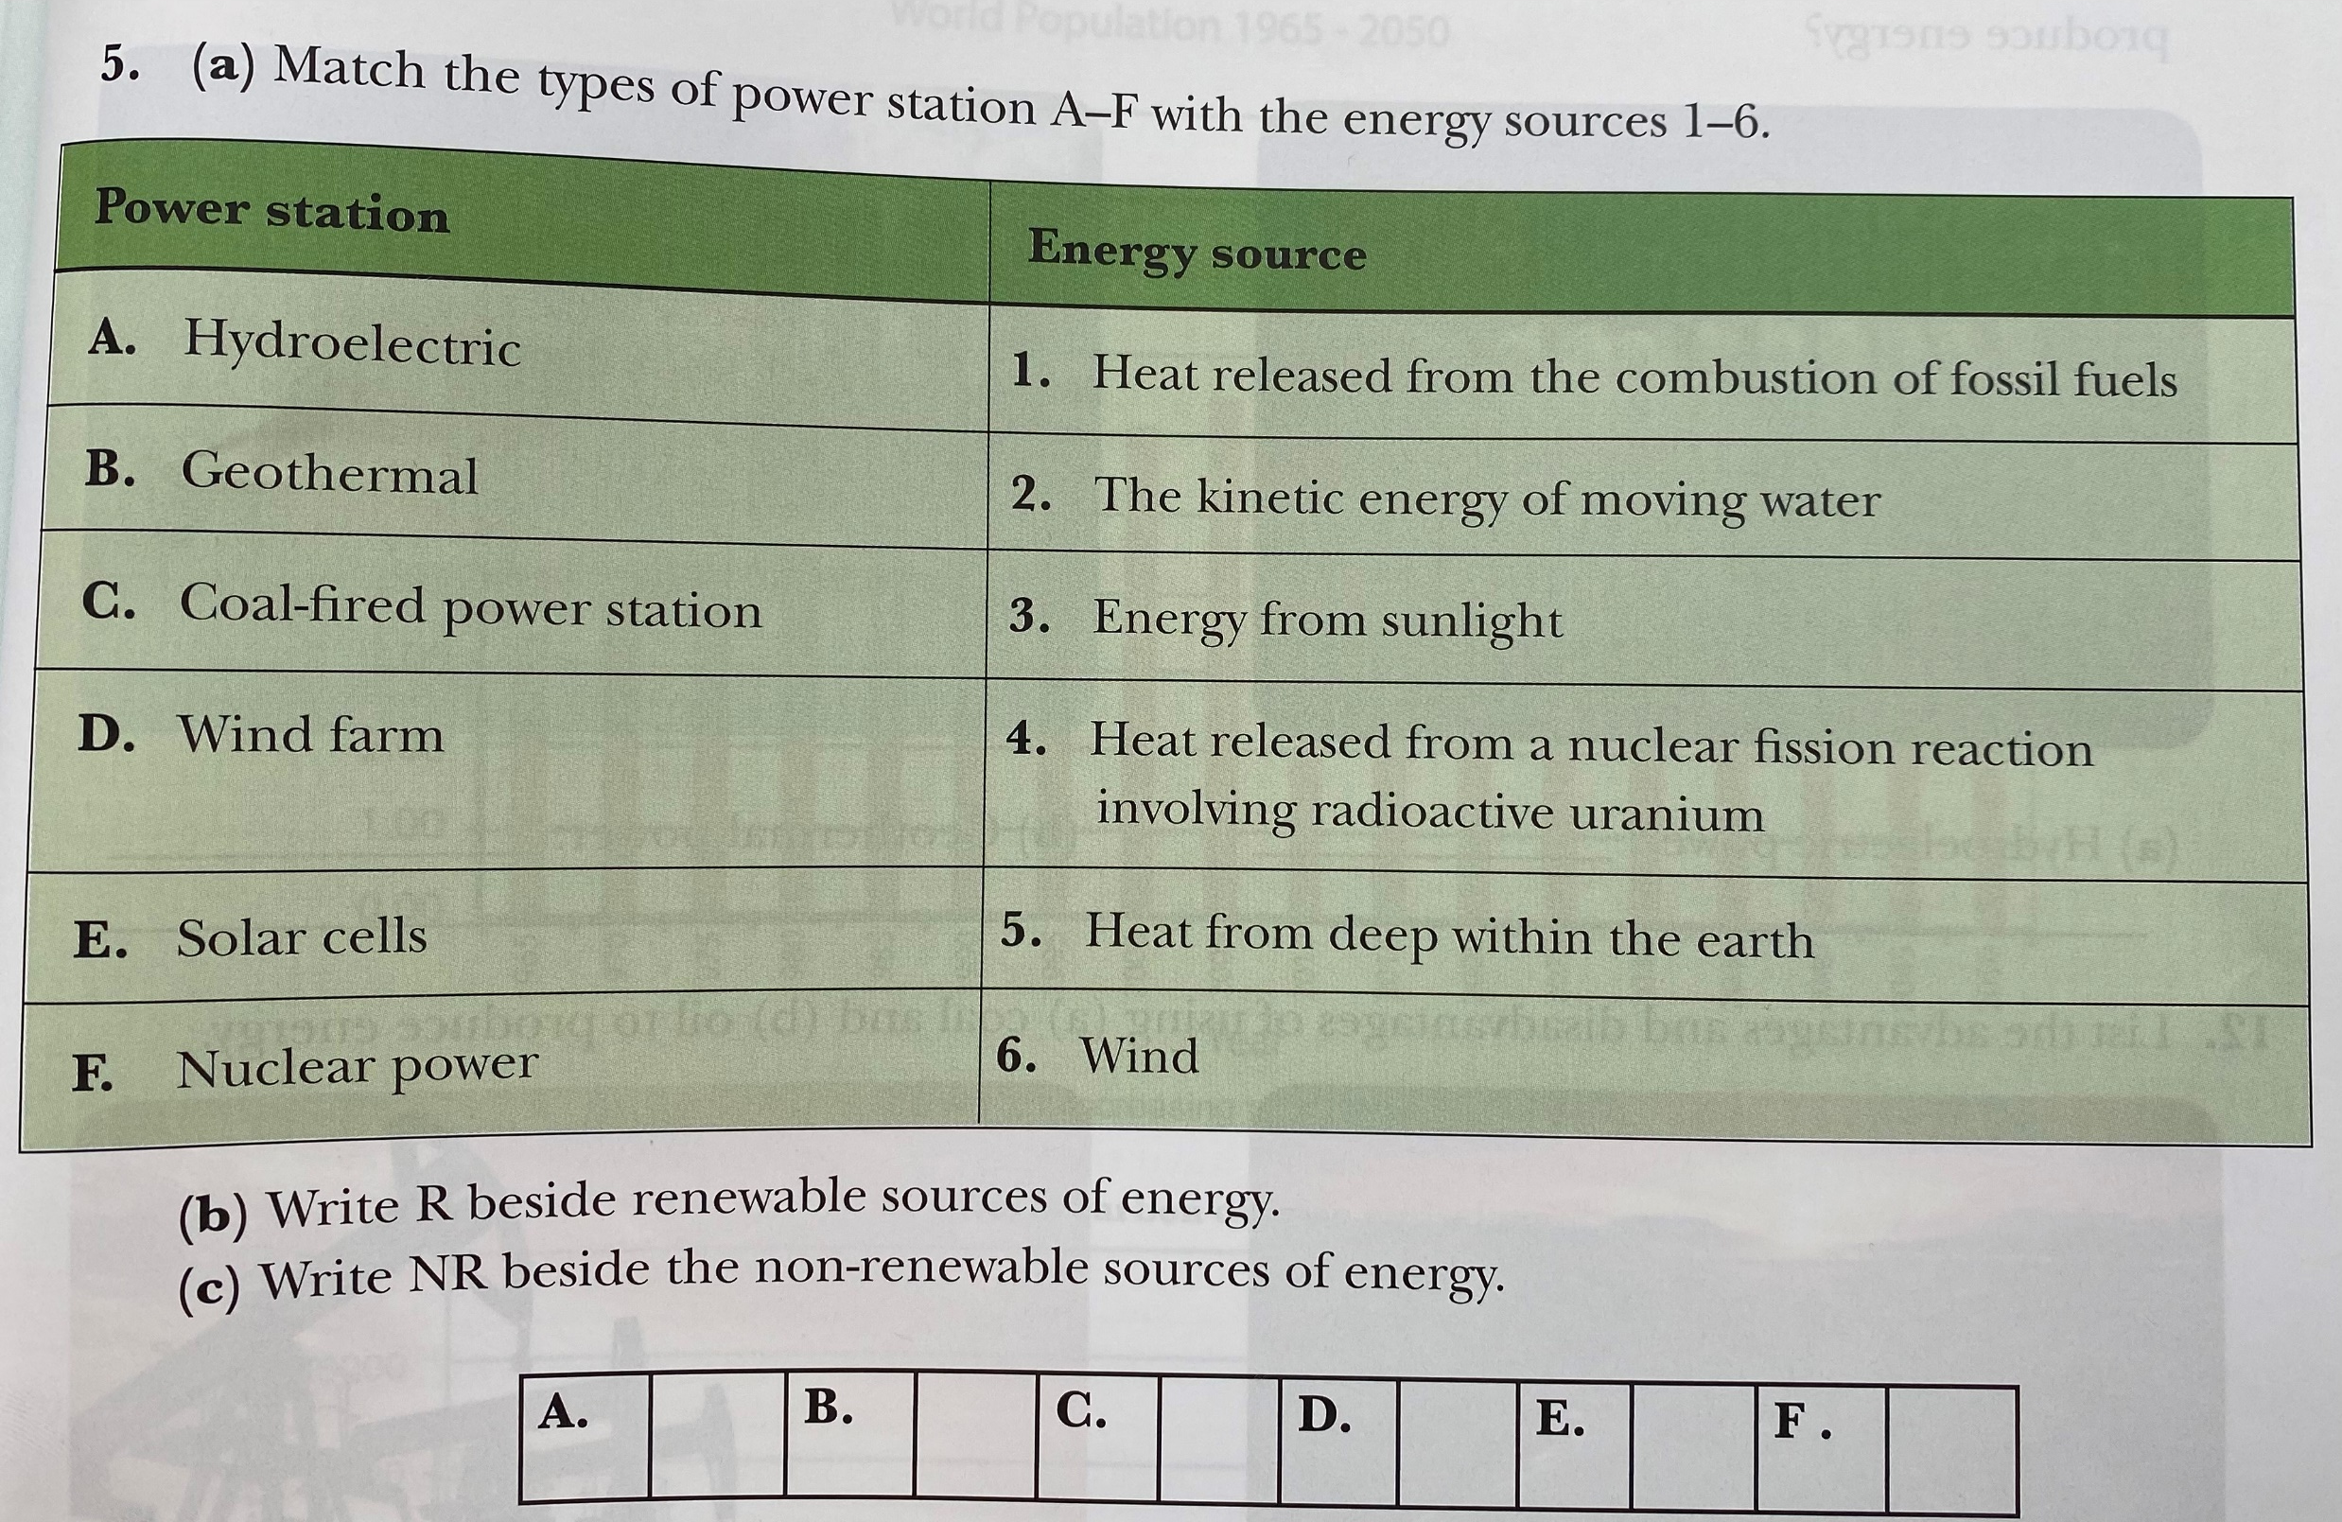

Slide 24
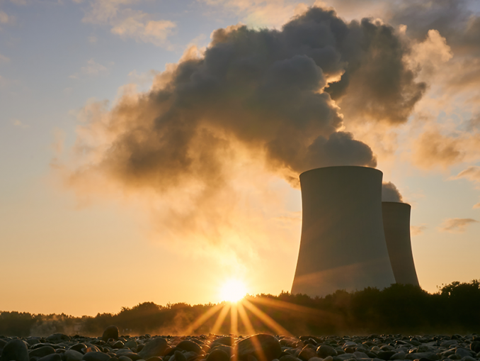
Nuclear power (alternative energy source)
Nuclear power is a clean and efficient way of boiling water to make steam, which turns turbines to produce electricity.
Nuclear power plants produces radioactive waste.
This waste gives off radiation that can be harmful.
Notes:
In 1986 a very serious accident happened at the Chernobyl nuclear power plant in what is now the country of Ukraine. Radioactive gases leaked out of the plant and into the air. They ruined crops and livestock and caused harm to many people.

Slide 25
Nuclear power
Advantages:
High energy output
Very little greenhouse gas emissions
Reduced our dependence on fossil fuels
Very efficient in the production of energy
Disadvantages:
Safety issues
Problems storing used fuel and its disposal
Mining and refining of uranium, the fuel used in nuclear power stations, can have environmental and health issues.
The limited life span of a nuclear reactor, which is approximately 60 years.
Notes:
Radioactive materials can also get inside the body if people breathe it in, or eat or drink something that is contaminated. People living close to the nuclear power plant who are exposed to radiation could experience long-term health effects such as cancer.

Slide 26
Nuclear power stations produce energy without producing carbon emissions
Name two reasons why some people oppose/disagree with nuclear power

Slide 27
The consequences of nuclear energy
Involves the production of radioactive substances.
Being exposed to radioactive substances can cause death, cancer and birth defects.
Accidents can happen e.g. chernonbyl
Notes:
Radioactive substances are atoms that decay naturally. They can give off alpha particles, beta particles and gamma radiation. Over billions of years, these two elements slowly change form and produce decay products such as radium and radon.

Slide 28
Appreciate how the future energy needs on earth can be met.
Notes:
https://www.curriculumonline.ie/getmedia/cd97acf7-dafb-464e-9dc9-9b01086cc3df/Meeting-Current-and-Future-Energy-Needs_2.pdf

Slide 29
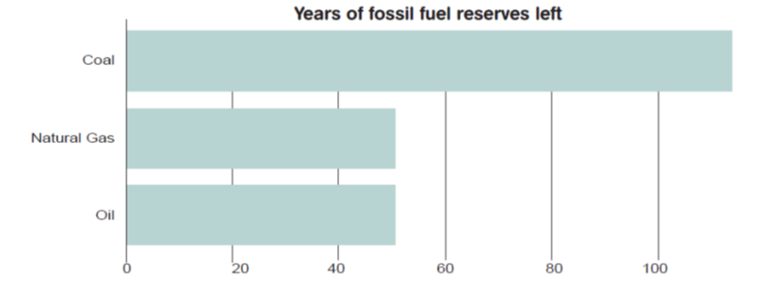
Meeting current global energy needs
Currently most of our energy is generated from burning fossil fuels.
This is not a sustainable way to meet future energy needs.

Slide 30
Changing energy demands
By 2030 the world energy demand will have increased by 55 % compared today.
Our future energy needs must be met by renewable energy sources.
Renewable energy resources are sustainable because they will not run out and do not produce carbon

Slide 31
Sustainability
“Ensuring a resource does not run out”

Slide 32
Sustainable energy usage
Using energy that will not damage our environment
Using energy efficiently and without wastage
Using energy so that future generation can use to

Slide 33
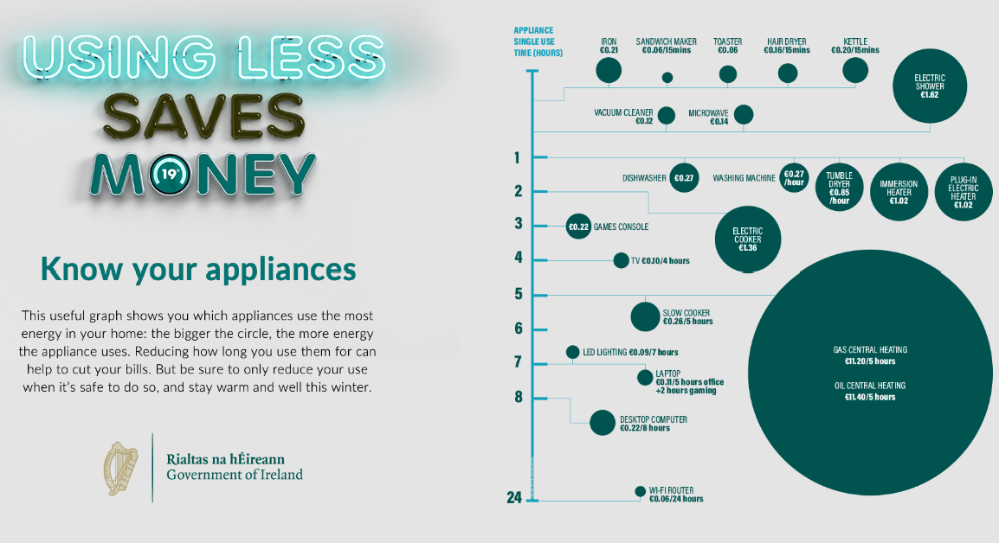
Notes:
With the ongoing war in Ukraine affecting the cost of energy, many of us are facing a challenging winter.

Slide 34
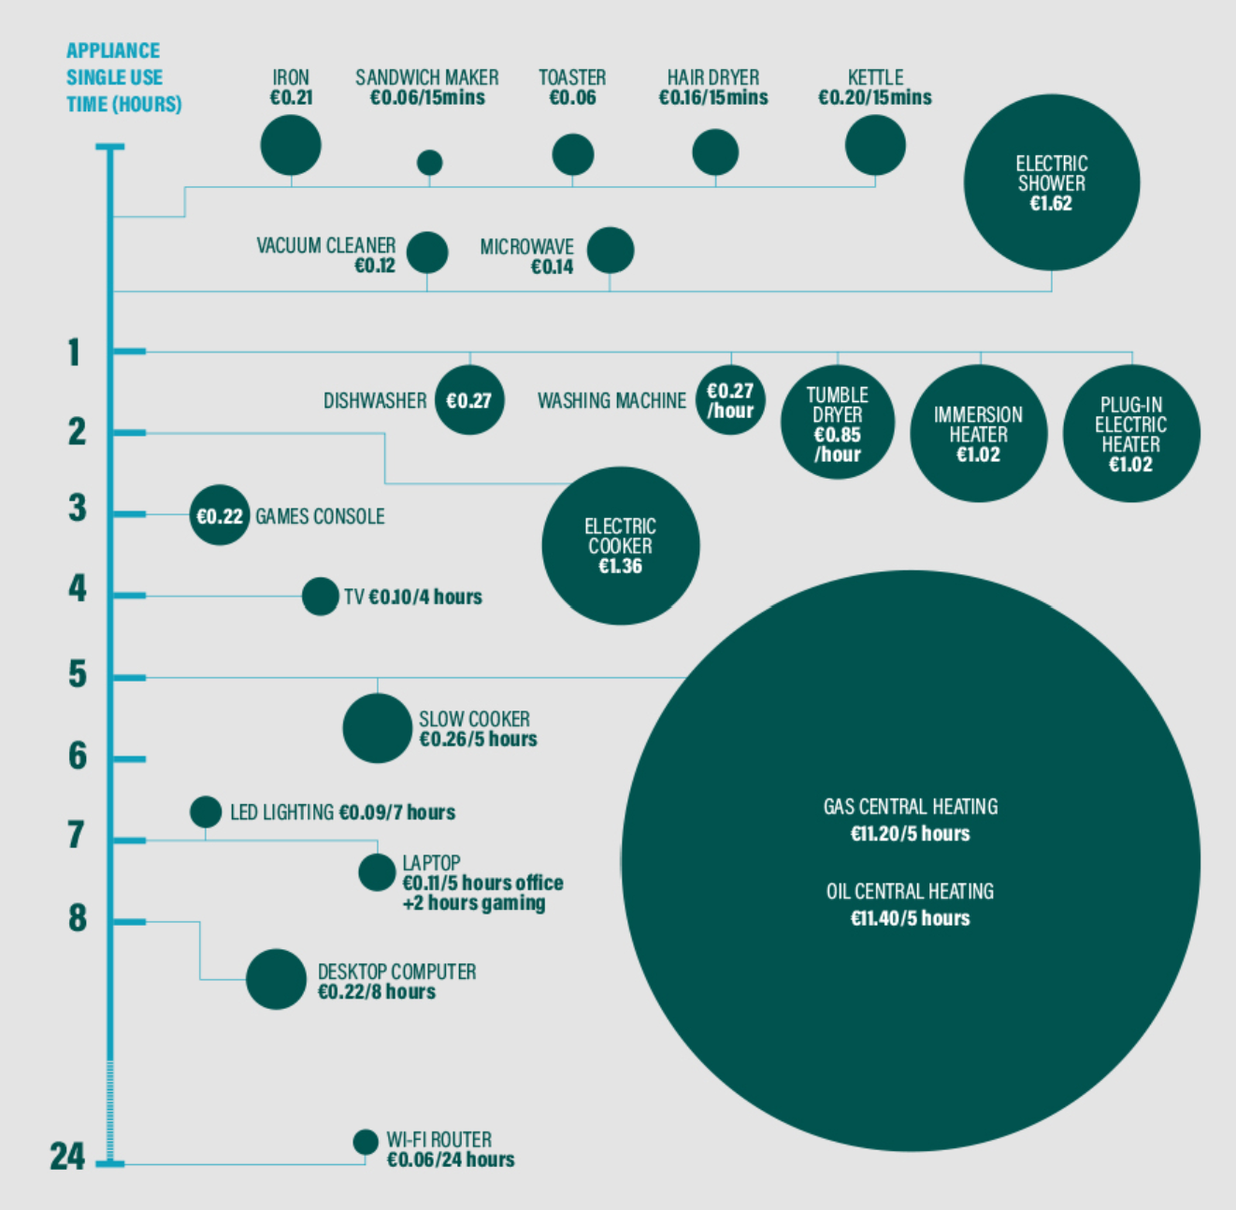

Slide 35
Ideas to make energy more sustainable
Lights
Heating
Water
Notes:
Insulate buildings – heat loss
Public transport – ff
Plug out appliances
Choose renewable energy
https://www.seai.ie/community-energy/schools/schools-documents/5th_and_6th_Class_Chapter_5.pdf

Slide 36
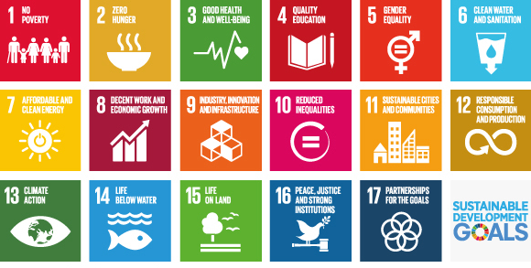
Sustainable development goals A set of targets relating to future international development
Notes:
a set of targets relating to future international development. They are created by the United Nations and promoted as the Global Goals for Sustainable Development. They replaced the Millennium Development Goals that expired at the end of 2015. The SGDs run from 2015 to 2030.

Slide 37
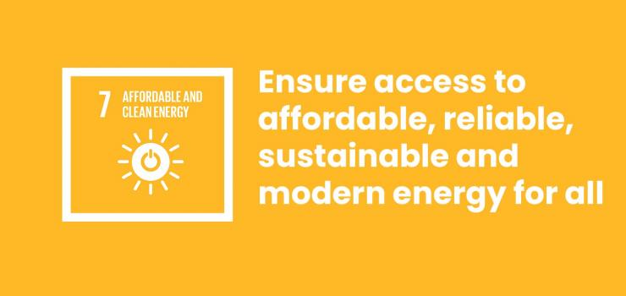
Goal 7 and its Targets
To ensure access to affordable, reliable, sustainable, and modern energy for all.

Slide 38
Renewable energy sources are the only sustainable way to meet future energy demands.
Explain this statement
Would you agree / disagree and state why
Notes:
Project title - How to meet current and future energy needs.
https://www.curriculumonline.ie/getmedia/cd97acf7-dafb-464e-9dc9-9b01086cc3df/Meeting-Current-and-Future-Energy-Needs_2.pdf

Slide 39
Research title: How to meet current and future energy needs.
Choose an energy source(s) that you think that can meet the current and future energy needs.
State why you think it can meet future energy needs
List the advantages/ disadvantages
Notes:
Research the topic using your Ipad and/or other sources. Present your findings either as a poster, pamphlet, keynote/powerpoint/ Prezi, video, drama, song or any other means.

Slide 40
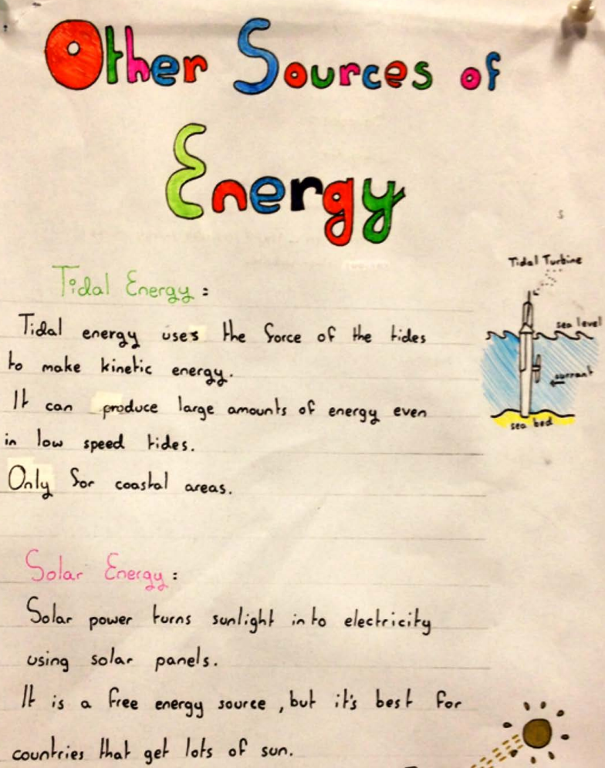

Slide 41
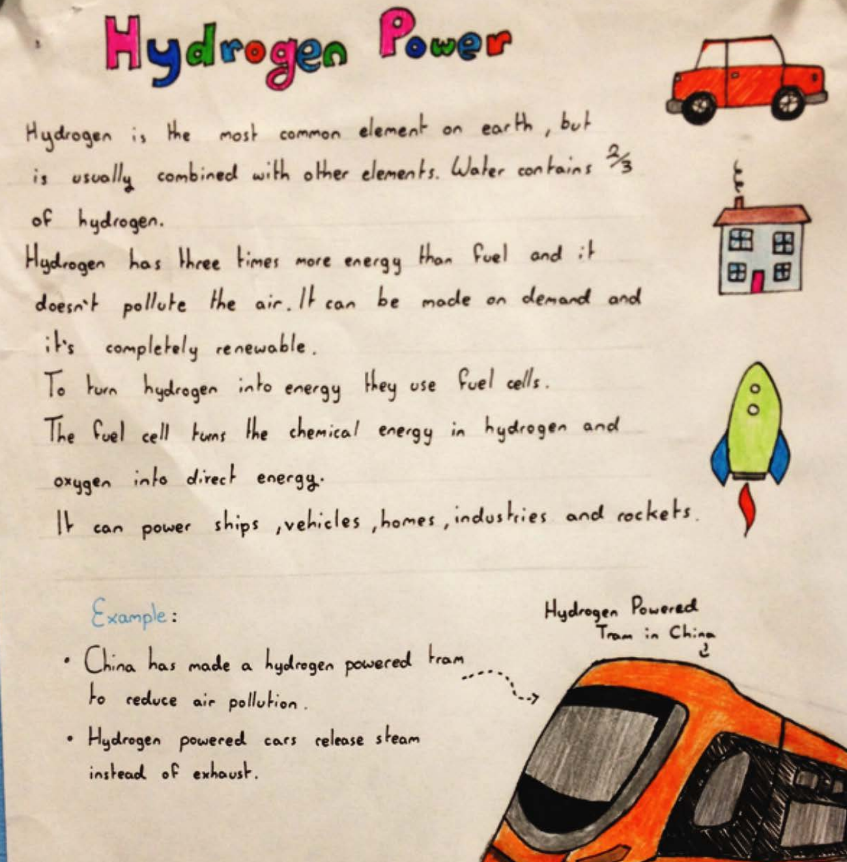

Slide 42
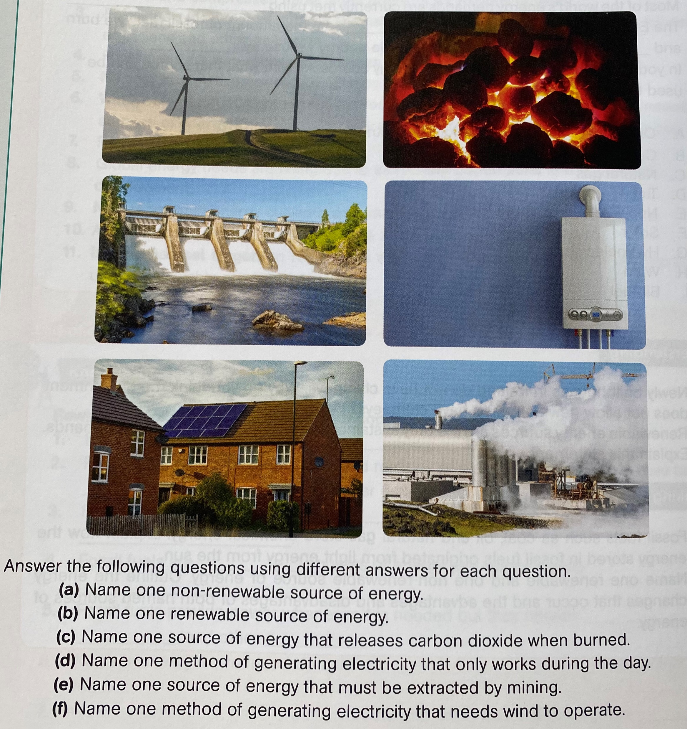
Name the energy sources and complete the questions

